Slide 1

WELCOME

Slide 2

HOSPITAL MANAGEMENT SYSTEM
Group Members:
Anusha Yaramala
Rangineni Vishwitha
Sai Satya Pavan Pandu Vanka
Chennareddy Muni Deepak Kumar
Dinesh Reddy Puthalapattu
Makala Jaswanth
Ganjinaboina Tejaswi
Chandrupatla Divya Anusha

Slide 3
CONTENTS
Project Description
Team Members Responsibilities
Existing System
Proposed System
Advantages of Proposed System
Core Requirements
Implementation Details
Testing Experiences
Database and it’s Design
Feedback
Code Inspection
Limitations
Project Demo
Conclusion

Slide 4
PROJECT DESCRIPTION
The goal of Hospital Administration is twofold: firstly, to assist patients in managing their records, and secondly, to enable hospitals to better manage their patient population.
This project is motivated by the significant challenges patients encounter in navigating healthcare systems.
It focuses on patient administration.

Slide 5
TEAM MEMBER’S RESPONSIBILITIES
Pavan – Team Lead and helps in all aspects of project
Vishwitha – Requirements Lead
Deepak – System Administrative Lead
Anusha – Front End Configuration
Dinesh – Back End Configuration
Tejaswi – Documentation Lead
Jaswanth – Testing Lead
Divya Anusha – UI Designer

Slide 6
EXISTING SYSTEM
The current system at the hospital relies on manual processes for gathering patient information. However, this manual approach has several drawbacks:
Limitations of the Manual System :
Time-consuming: Gathering data manually takes up valuable time.
Prone to errors: Manual input increases the likelihood of mistakes in the results.
Requires significant manpower: It demands a considerable workforce to achieve satisfactory outcomes.
Lacks data security: Manual systems are vulnerable to breaches in data security.
Slow data retrieval: Retrieving information from manual records is a time-consuming task.
Low accuracy percentage: Due to human involvement, the accuracy level tends to be lower.
Delayed report generation: The process of generating reports is often prolonged in a manual system.

Slide 7

PROPOSED SYSTEM
The goals for our proposed system include ensuring extensive maintenance of records, generating rapid reports, conducting precise and efficient calculations, offering concise information provision, ensuring data security, and facilitating timely completion of flexible transactions.

Slide 8
ADVANTAGES OF PROPOSED SYSTEM
Minimized data redundancy, leading to fewer updating errors and enhanced consistency.
Enhanced user access to data via host and query languages.
Data security measures.
Lowered costs associated with data entry, storage, and retrieval.

Slide 9
CORE REQUIREMENTS
User-friendly Interface: The software boasts an intuitive and visually pleasing interface crafted to enhance the efficiency of hospital management.
Patient Management: Seamlessly handle patient records, encompassing personal information, medical history, diagnoses, treatments, and appointments.
Appointment Scheduling: Facilitate simple scheduling and monitoring of patient appointments for optimized time utilization and resource allocation.
Staff Management: Streamline the management of hospital personnel, including doctors and administrative staff, by organizing their roles, schedules, and contact information effectively.
Reports and Analysis: Produce thorough reports and perceptive analytics concerning patient metrics, financial gains, and key performance indicators, facilitating informed decision-making based on data.
Security and Privacy: Establish strong security protocols to safeguard confidential patient information, ensuring adherence to privacy regulations.

Slide 10
IMPLEMENTATION DETAILS
Hardware Requirements:
Software Requirements:
Processor | INTEL Pentium 4 or Higher
RAM | 512 MB
Hard Disc | 20 GB
Operating System | Windows XP or Higher
Front End | PHP
Back End | MYSQL
Server | XAMP

Slide 11
Testing - Unit Testing and Functional Testing
In unit testing, we have found that breaking down code into small, testable components is key. It's an intricate dance between isolating specific functionalities and ensuring they operate as intended. The precision required often leads to uncovering edge cases and subtle bugs that might otherwise slip through the cracks.
On the other hand, functional testing is more holistic, focusing on the behavior of the system as a whole. It's like taking a step back to see how all the individual parts harmonize.
We have noticed that functional testing shines when it comes to verifying user interactions and overall system performance. Both approaches complement each other, providing a comprehensive safety net for software development.
Through these experiences, we have learned the importance of balance - between granularity and breadth, between meticulousness and efficiency - in crafting robust, reliable software.

Slide 12
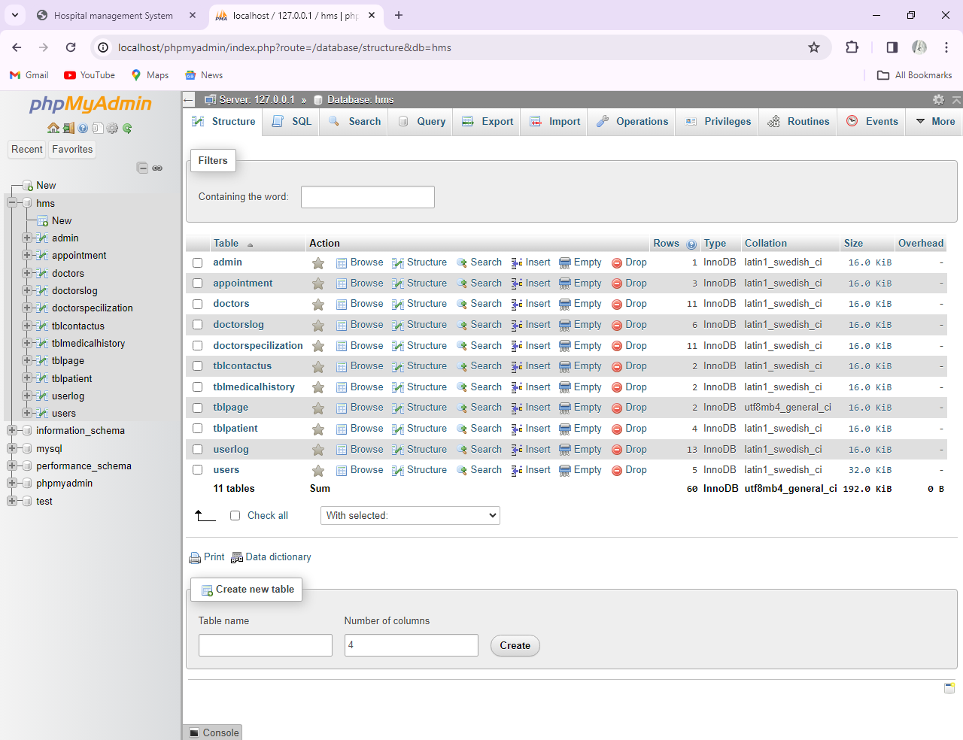
DATABASE

Slide 13
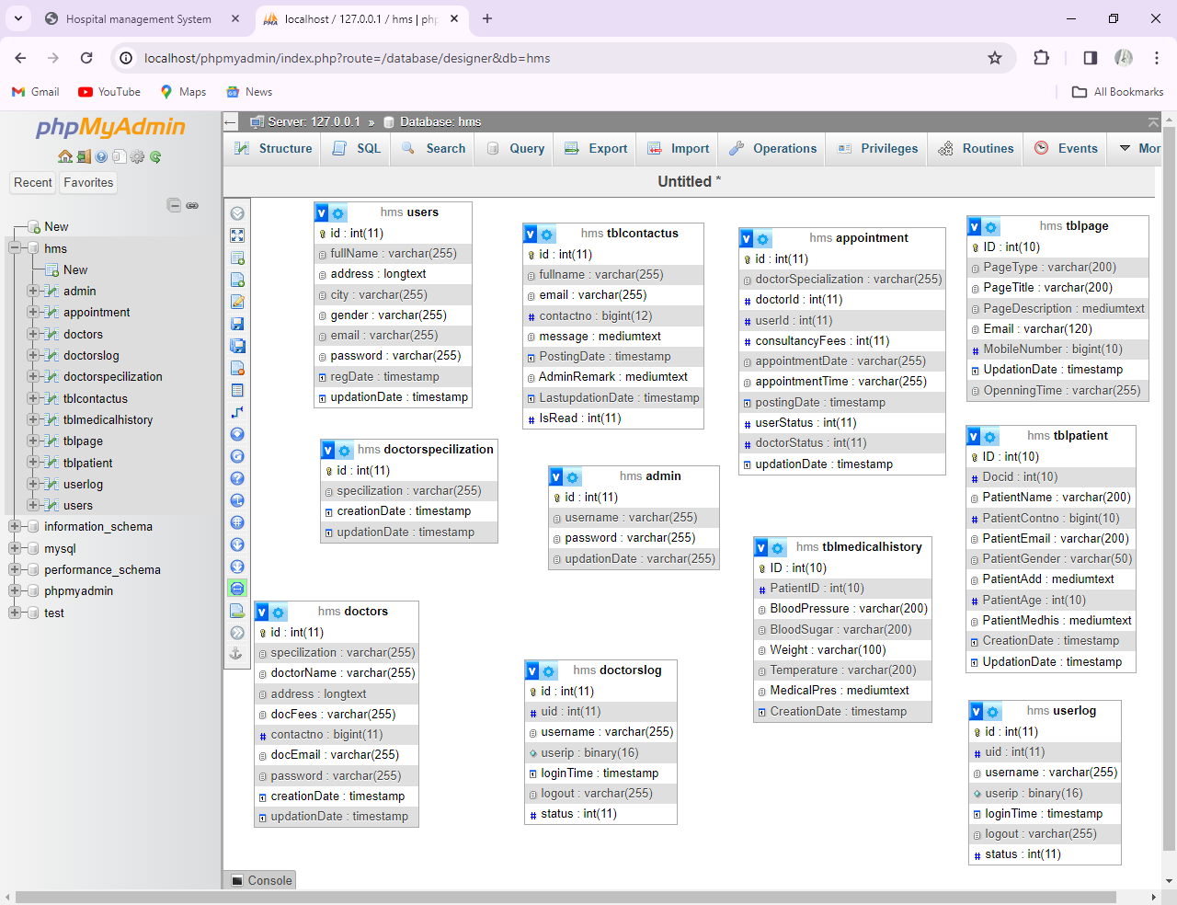
DATABASE DESIGN

Slide 14
FEEDBACK
We initiated a group meeting to discuss the development functionalities at the beginning of this project. Because PHP has a better interface and performs better, we chose it for this project.
Given that PHP runs quickly on the Apache web server. As since we were using the same web server, we chose to use PHP and MySQL for our database. All of the members of our team were familiar with the fundamentals of PHP, yet we were still able to pick it up quickly and put it into practice.
Now Succesfully we have implemented PHP through out our project which helped us to implement all the functionalities.

Slide 15
CODE INSPECTION
Debug Dynasty team have commented well about the mobile responsive design, which guarantees a smooth user experience, and the well-organized and clean codebase during the Code Inspection Session. We answered any queries that the Debug Dynasty group had.
Their guidance was really helpful in pinpointing areas that require enhancements and new features. We have already made the change to the code to make it easier to read and understand, but one important suggestion was to add user comments. We have implemented this feature.
The stakeholders also offered ideas for feature improvements, such as strengthening security protocols, enhancing reporting capabilities, and integrating with services. We have, despite the fact that some of these enhancements already have been practice.

Slide 16
LIMITATIONS
Time Limits: The scope and depth of our project have impacted by deadlines and time constraints.
Technical Challenges: Development may be slowed down due to hardware constraints and software errors.
Scope Creep: Project’s scope have gone through beyond which have resulted in additional work.

Slide 17
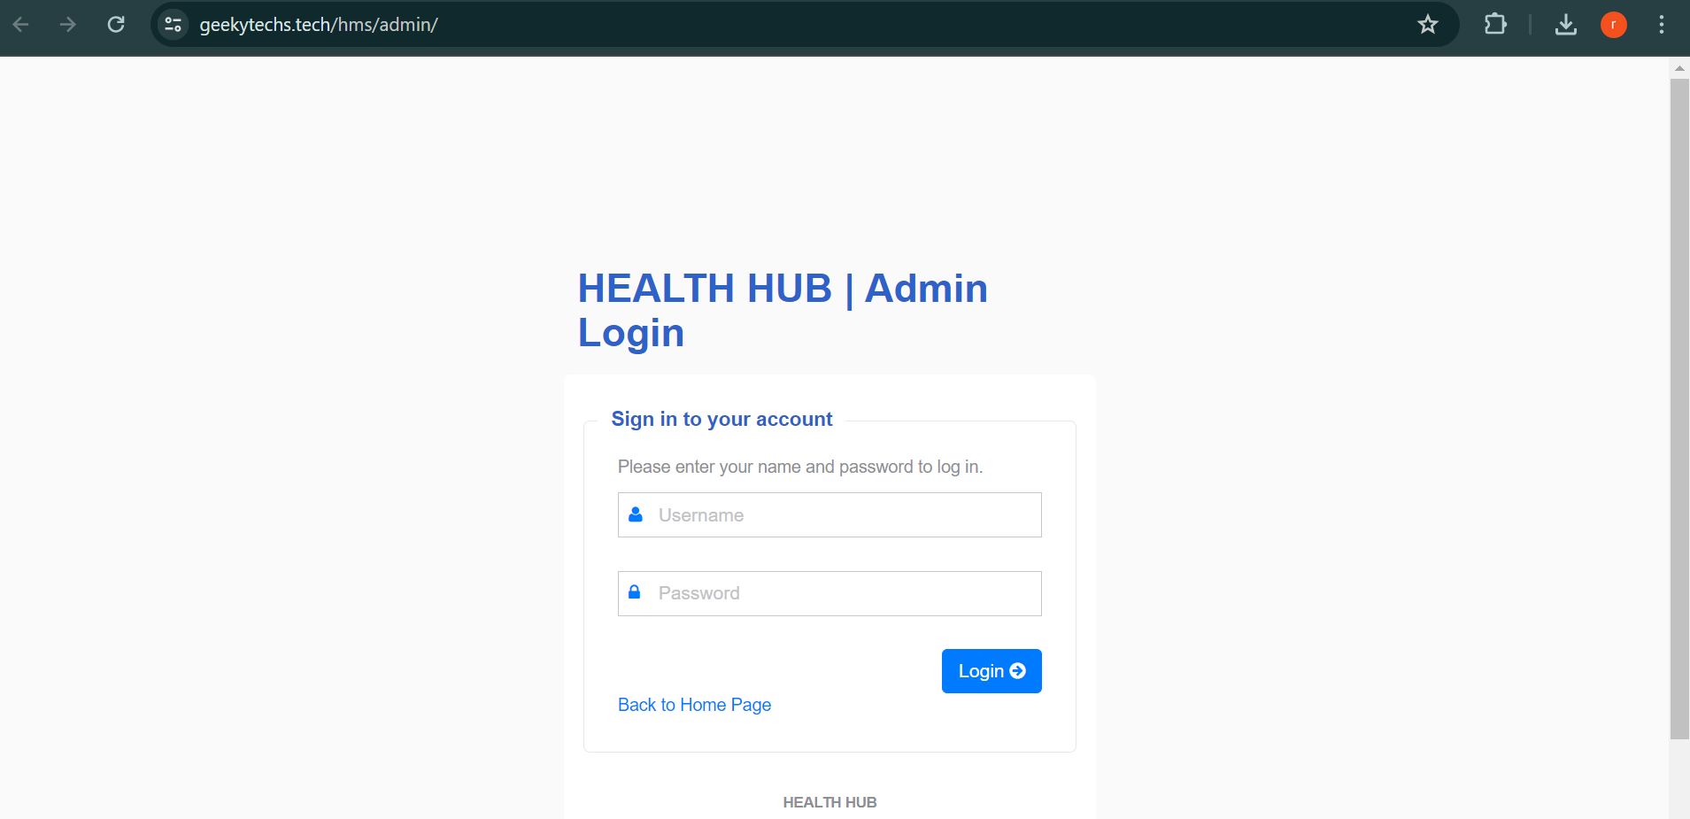
PROJECT DEMO Admin Login Page

Slide 18
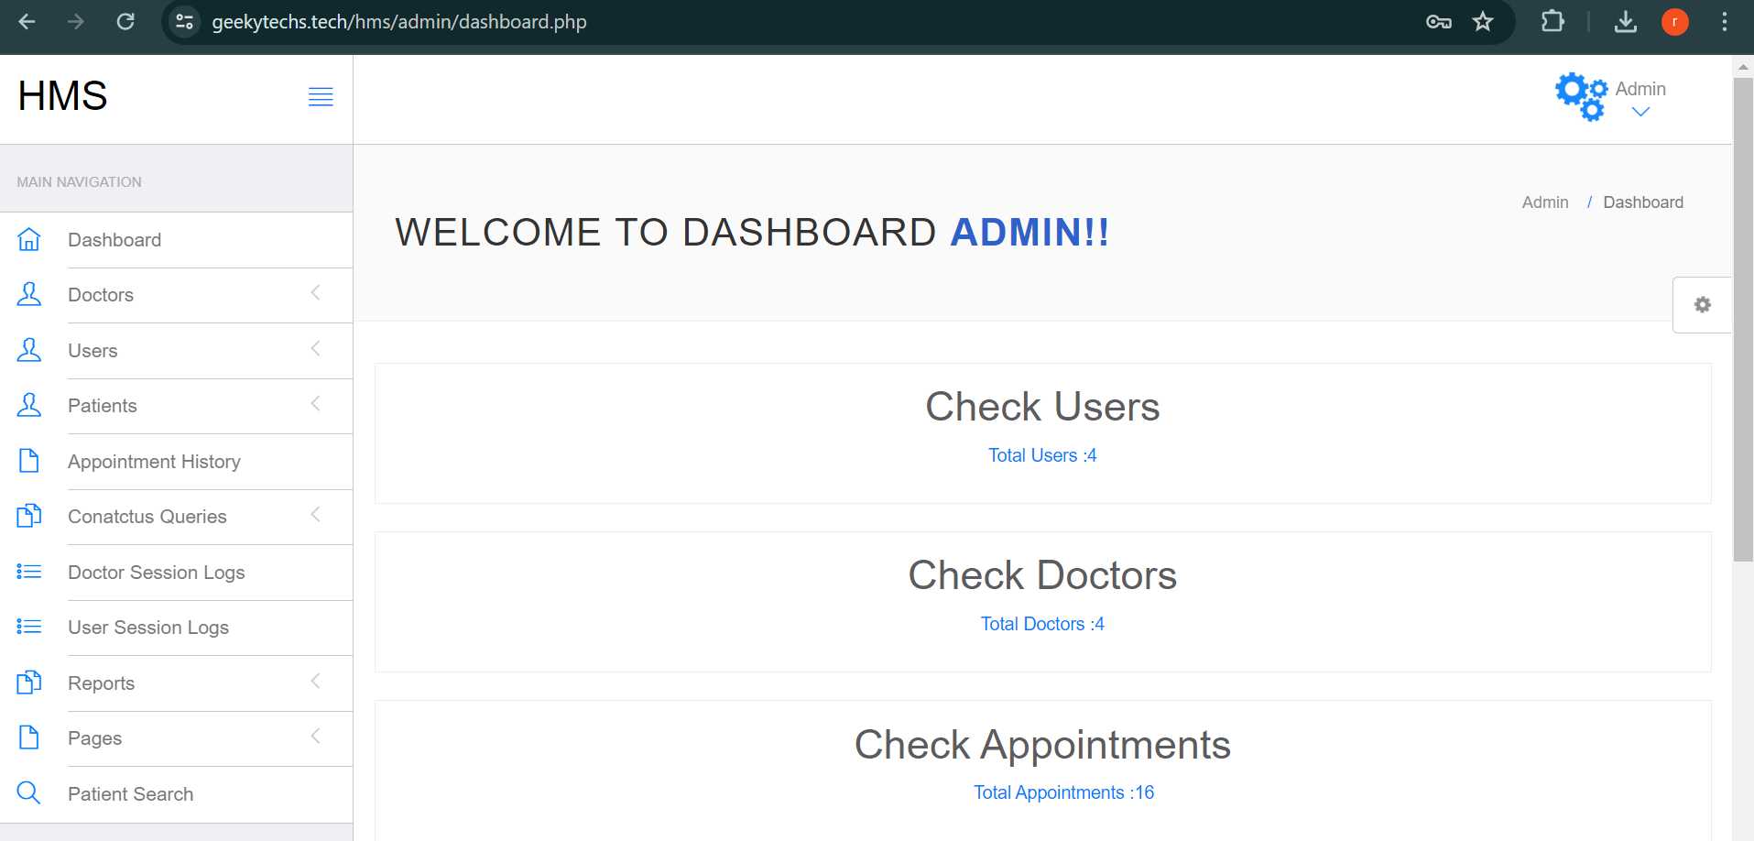
Admin Home Page

Slide 19
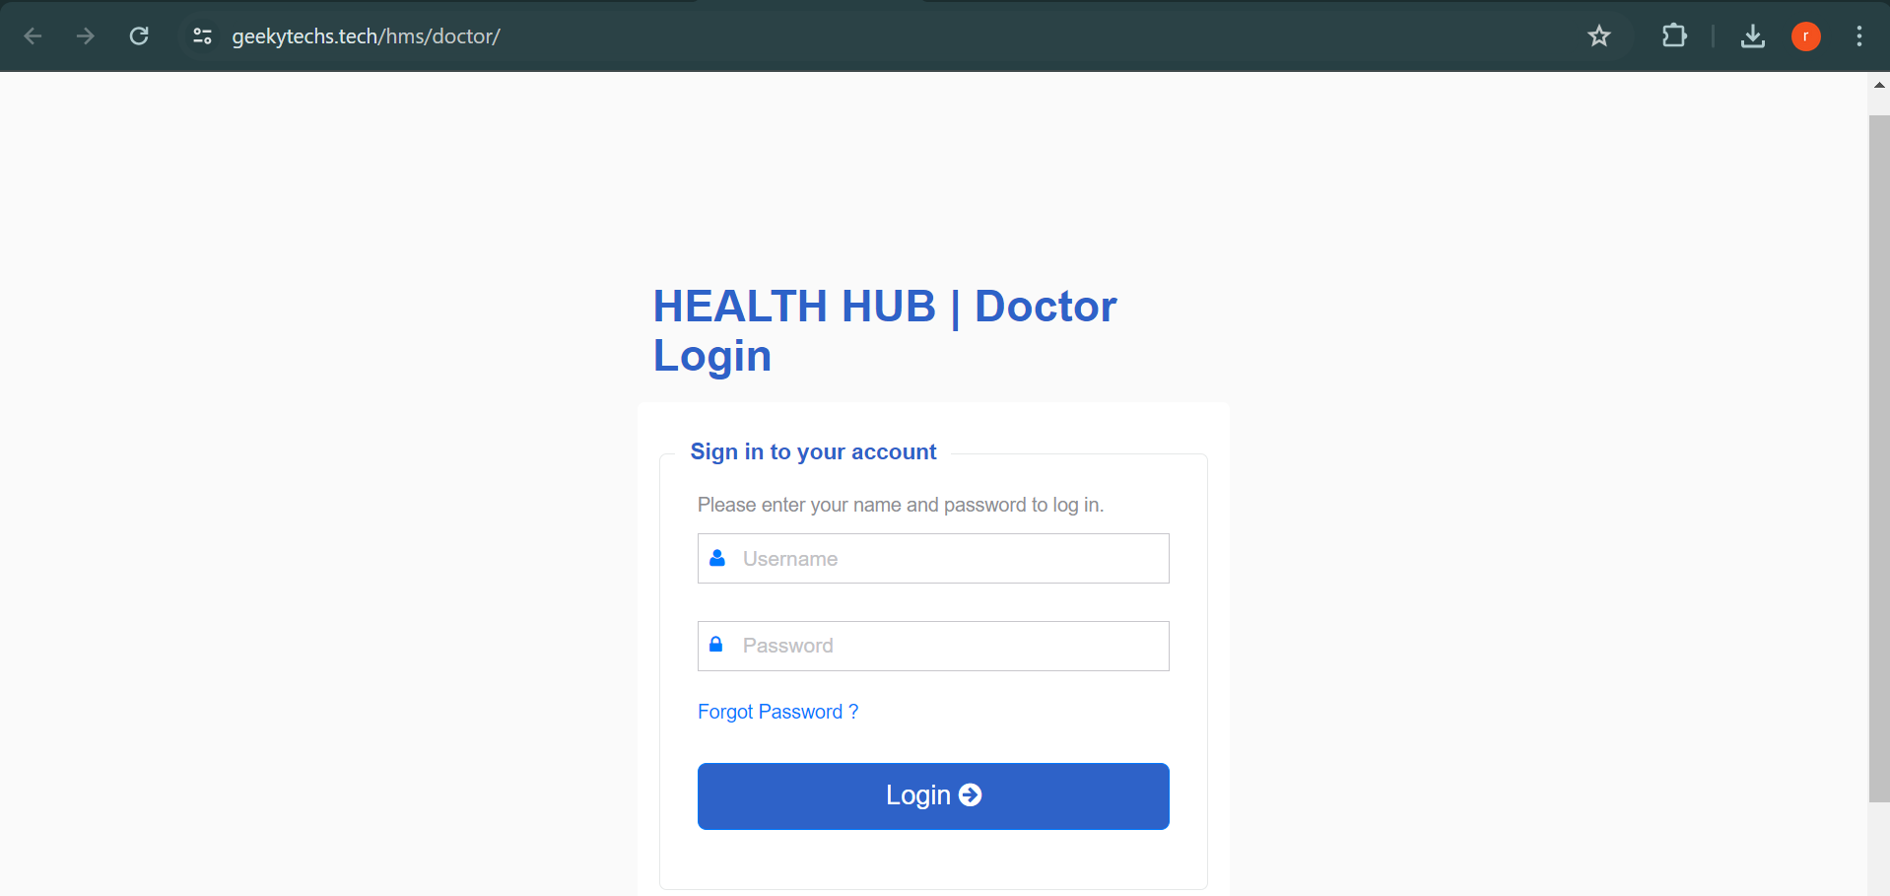
Doctor Login Page

Slide 20
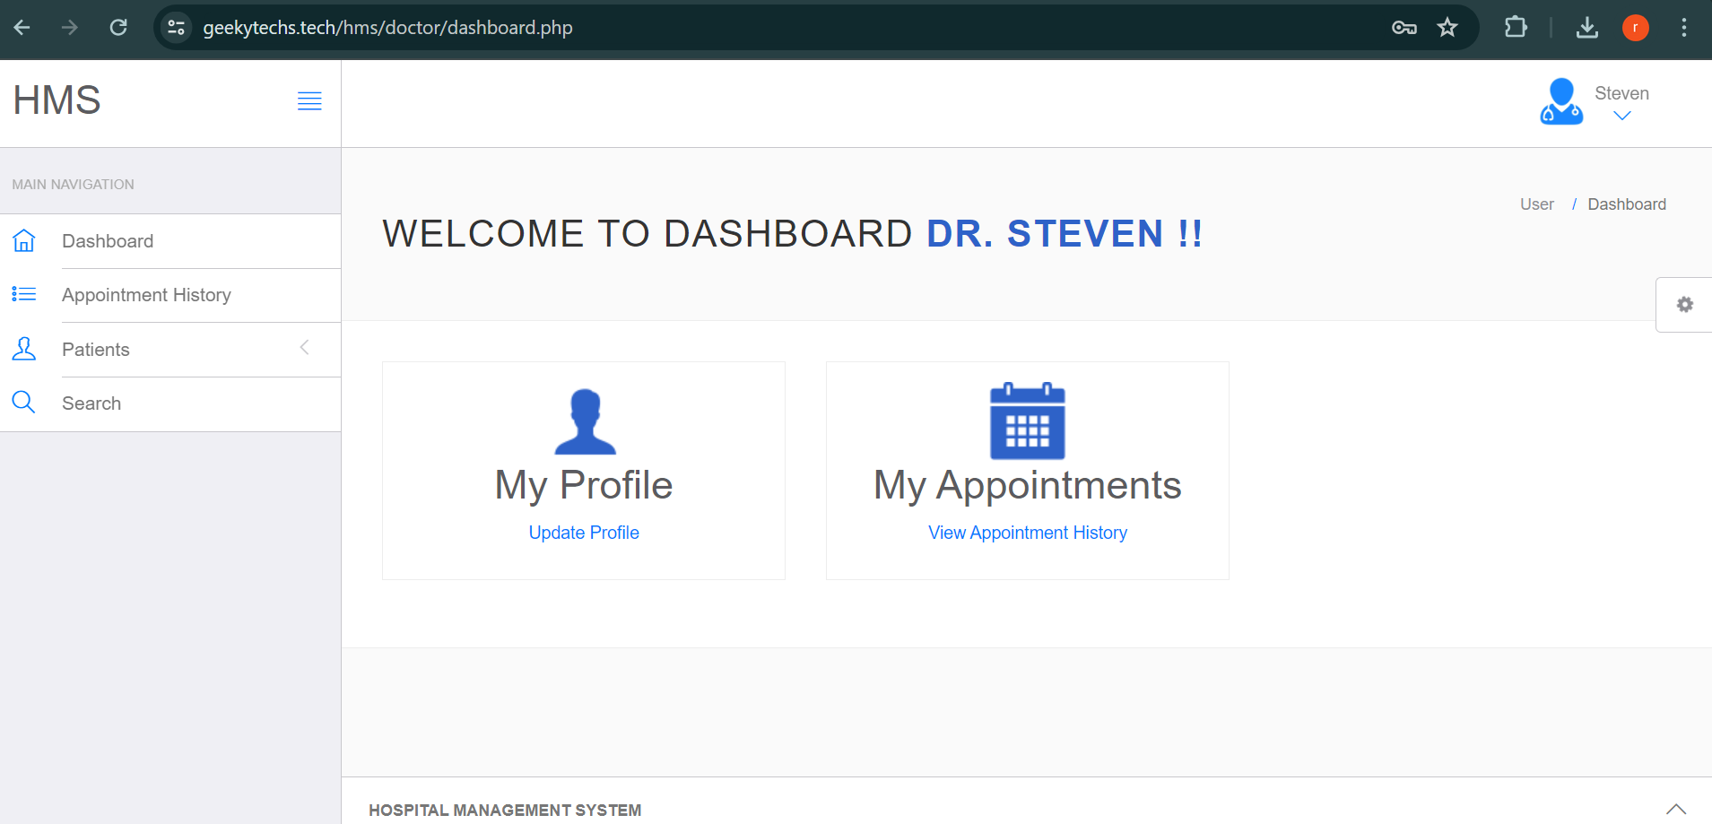
Doctor Dashboard

Slide 21
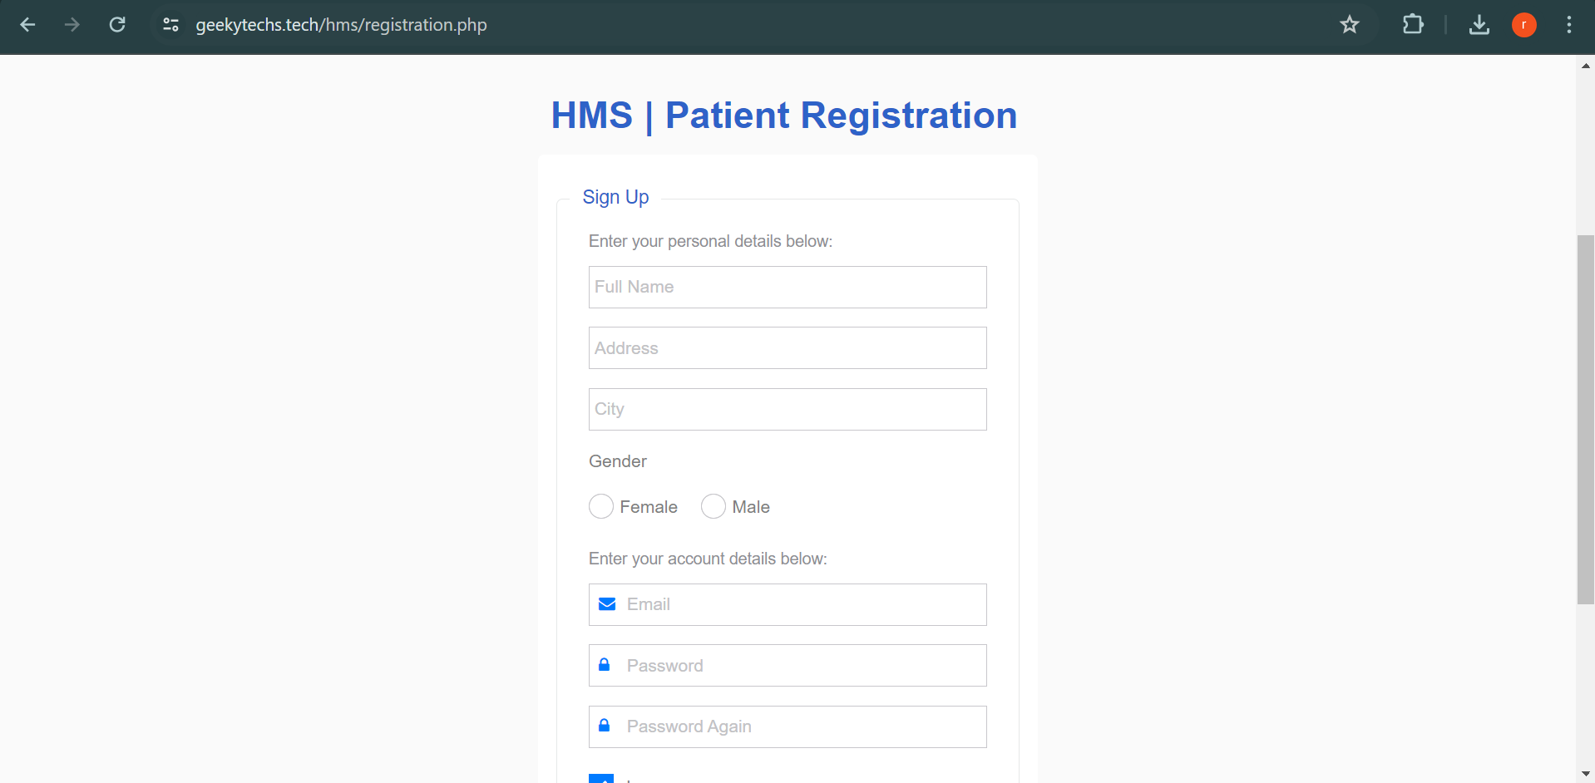
Patient Registration Form

Slide 22
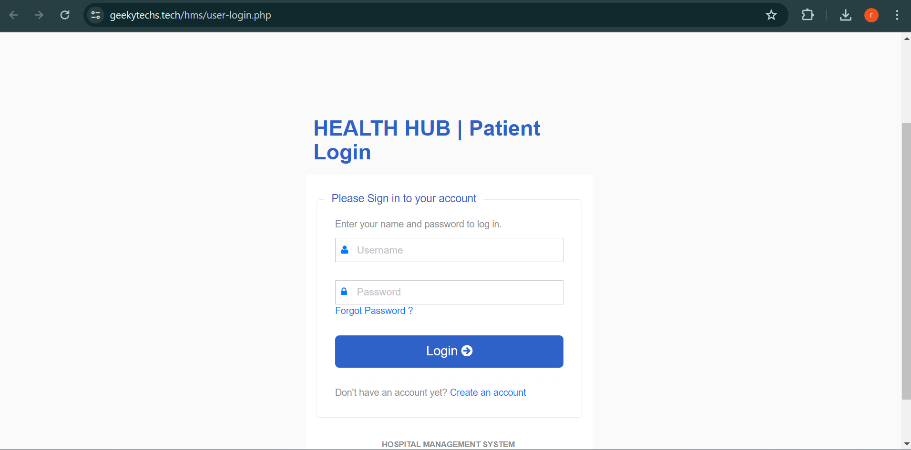
Patient Login Page

Slide 23
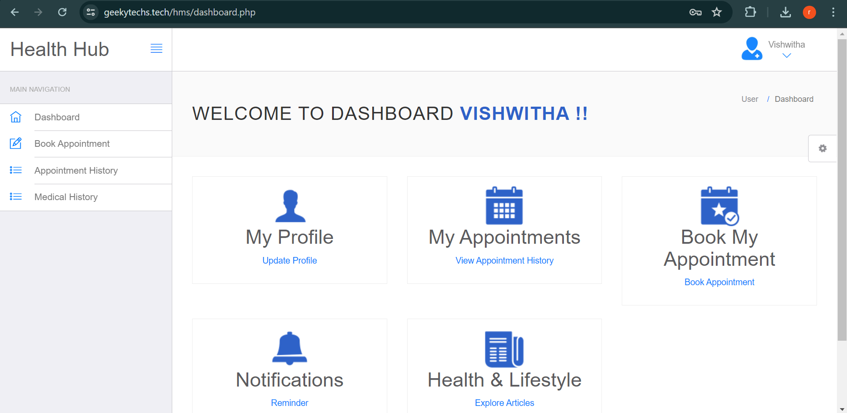
Patient Home Page

Slide 24
CONCLUSION
The Hospital Management System aims to modernize hospital operations by integrating technology. Computers streamline processes, replacing manual systems for efficiency and convenience. It encompasses all essential hospital functions, ensuring seamless management, and facilitates the storage of vast amounts of data.

Slide 25

Thank you

